Slide 1

Eastern Test Range Wind Data Reduction
Northrop Grumman Private/Proprietary Level I
Dan Salluce
19 December 2005

Slide 2

Wind Data Description
Data was collected from Boeing Shuttle Eastern Test Range (ETR) wind database provided on LiveLink but authored by:
  POC: Greg Manich
  The Boeing Company
  714-762-9004
150 sets of wind recorded every month
  800 altitude measurements every 25 m (0 – 20 km)
  Velocity [m/s]
  Azimuth [degrees]
  Total of 1800 wind set records for the year

Slide 3
Purpose / Approach
Purpose: A means to quantitatively determine the worst case wind set for the year is required
Worst case was previously defined as a wind profile which shows a large amount of sheer
  Sheer was assumed as the greatest difference in one altitude measurement to the next measurement
  Sheer can be a combination of velocity and azimuth
The gradient of the wind as a function of altitude will characterize the amount of sheer

Slide 4
Methodology
All wind data was read into Matlab structures from fixed width ASCII files
Each wind set was filtered in velocity to remove noise so that quantitative methods with the gradient would be meaningful
  6th order Low Pass Chebyshev Type I digital filter
  0.1 dB peak-to-peak ripple for velocity
  Cutoff frequency of 0.05
  (where 1.0 corresponds to half the sample rate)
  Azimuth was not filtered to avoid tracking 0→360 jump with the high order filter (future work can be done here)
Polar coordinates of V and Azimuth were changed to Cartesian East (X) and North (Y)

Slide 5
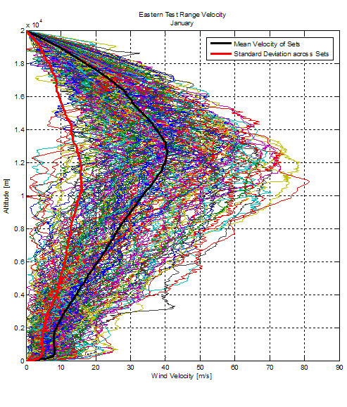
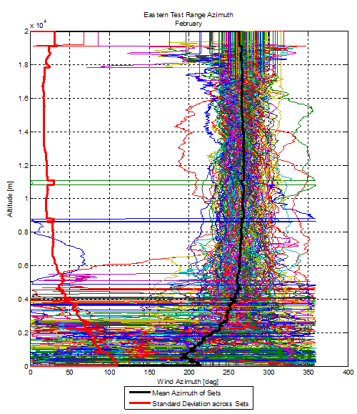
Sample Plots of Wind Month Data Sets

Slide 6
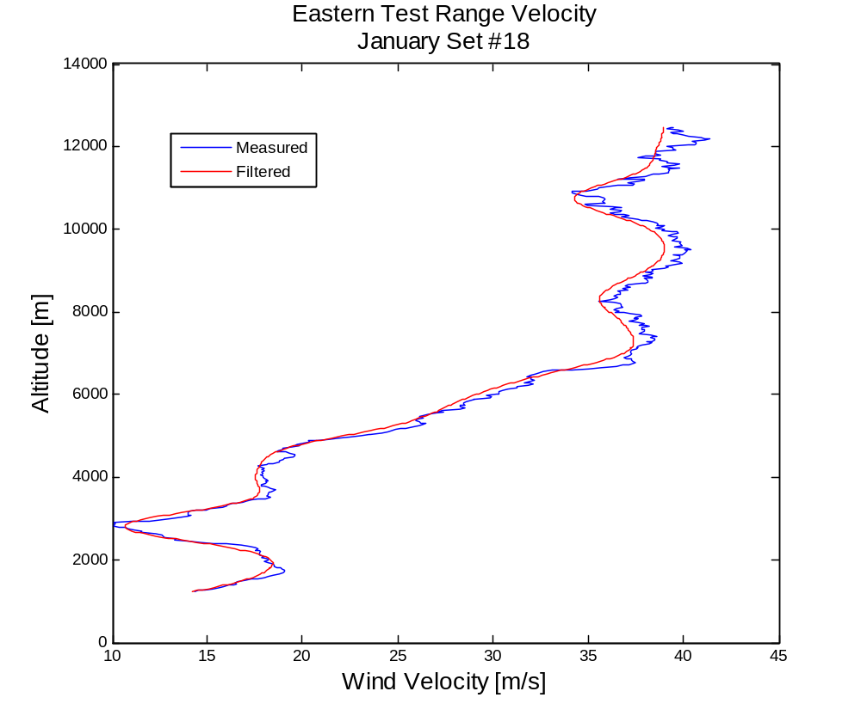
Sample Plot of Filtered Data

Slide 7
Methodology (cont.)
The gradient in X and Y was computed with changes in altitude (Δh = 25 m)
The norm of the gradient was taken for X and Y to get the total change of velocity
This gradient was then evaluated for each data set in the each wind month to find the maximum gradient
  This maximum value would represent the worst case sheer condition (i.e. greatest change in wind speed/direction with altitude)
  Ignored first couple data points and last few points to avoid erroneously reporting zero

Slide 8
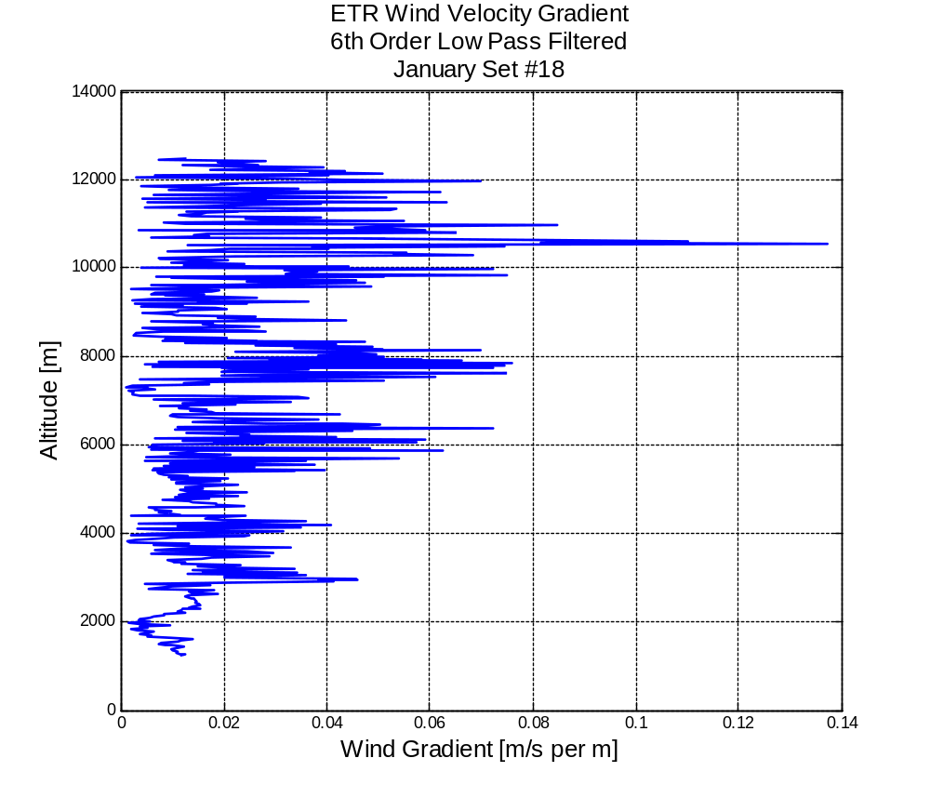
Sample Plot of Wind Gradient

Slide 9
Conclusions
The method employed results in the identification of a single record to be considered the worst from a perspective of sheer for each wind month
These worst case records are presented in the accompanying Excel spreadsheet so they can easily be saved in a format needed for other tools
All data was saved in Excel format for all the wind sets
All data has been saved and preserved for further analysis
  All plots of the sets for each month with mean and standard deviation are included in the ETR_Wind_Plots.doc Word file
  Matlab scripts which reproduce everything are available
    Matlab data is easier to parse than the Excel data
One case in February was also included as a worst case because although it did not show the greatest sheer, it had an unusually large wind speed (~85 m/s or 190 mph at around 25 kft)
All worst case data is in: WorstCaseSheer.xls

Slide 10
Worst Case Wind Gradient - Jan
Worst case sheer:
0.1372 [m/s per m]

Slide 11
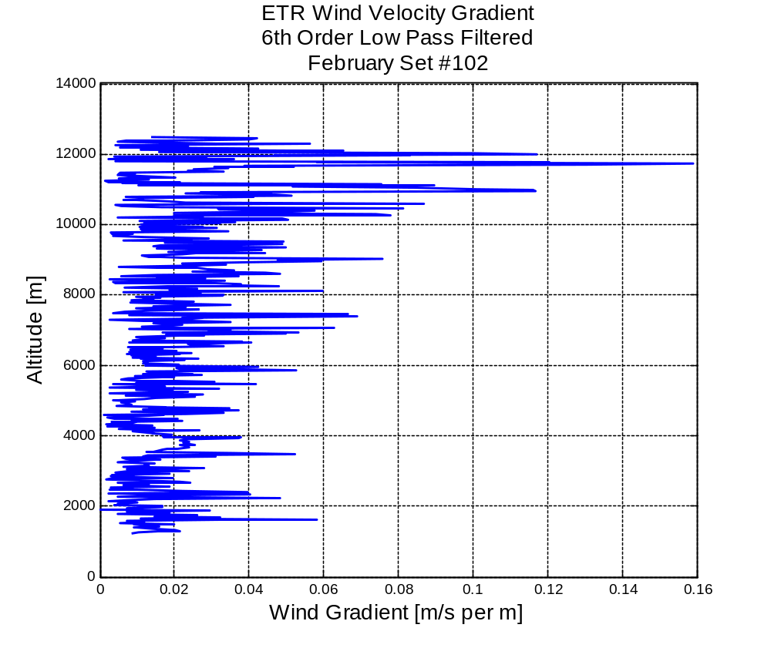
Worst Case Wind Gradient - Feb
Worst case sheer:
0.1588 [m/s per m]

Slide 12
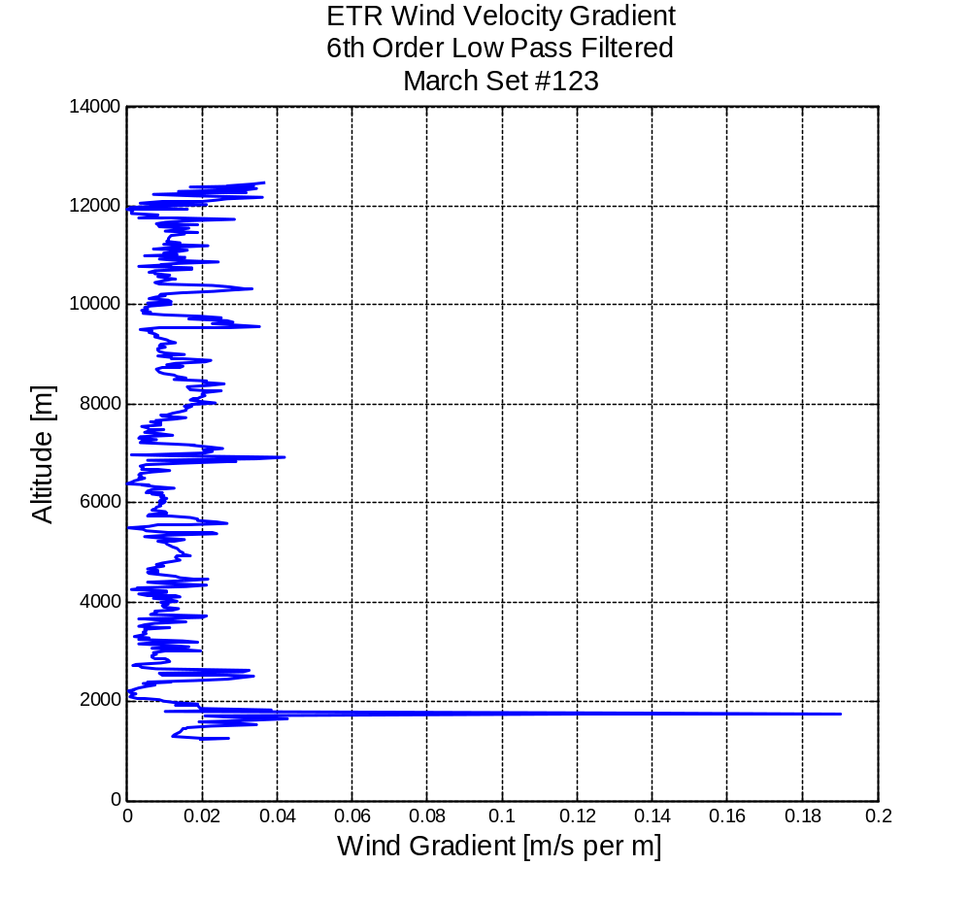
Worst Case Wind Gradient - Mar
Worst case sheer:
0.1899 [m/s per m]

Slide 13
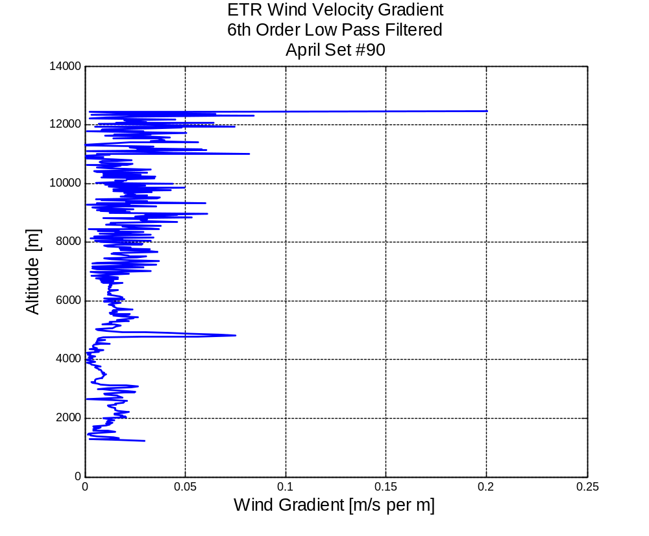
Worst Case Wind Gradient - Apr
Worst case sheer:
0.2007 [m/s per m]

Slide 14
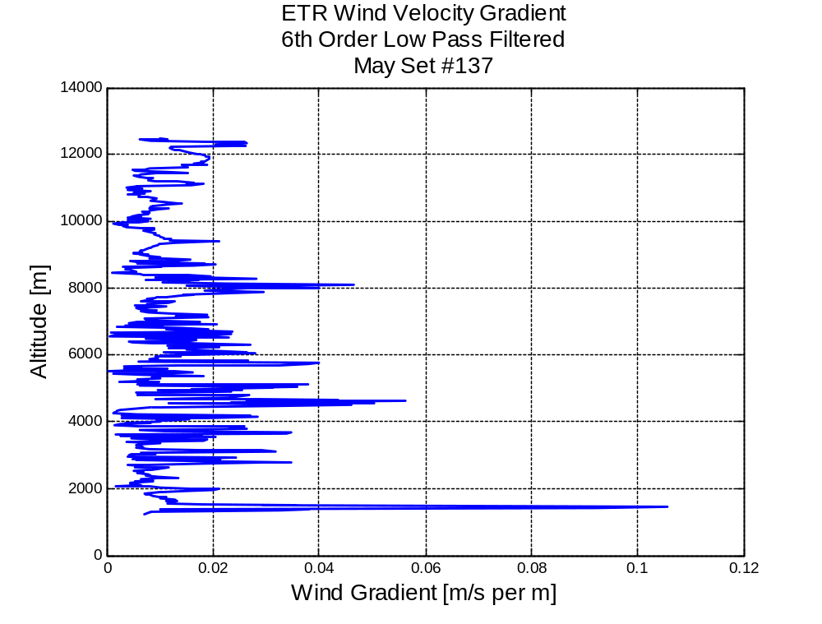
Worst Case Wind Gradient - May
Worst case sheer:
0.1057 [m/s per m]

Slide 15
Worst Case Wind Gradient - Jun
Worst case sheer:
--- [m/s per m]
Data looked inconsistent- will investigate further

Slide 16
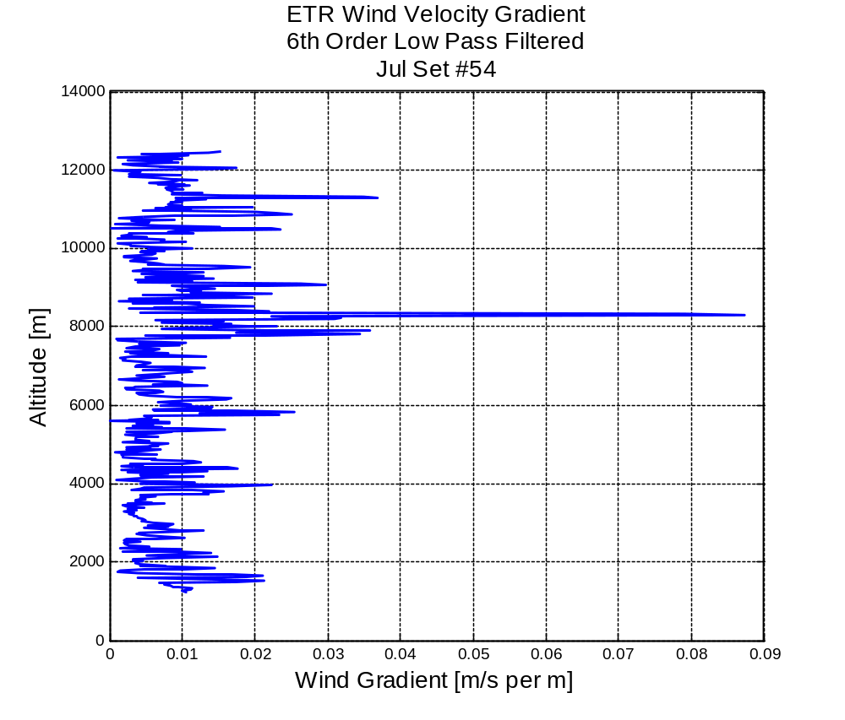
Worst Case Wind Gradient - Jul
Worst case sheer:
0.0872 [m/s per m]

Slide 17
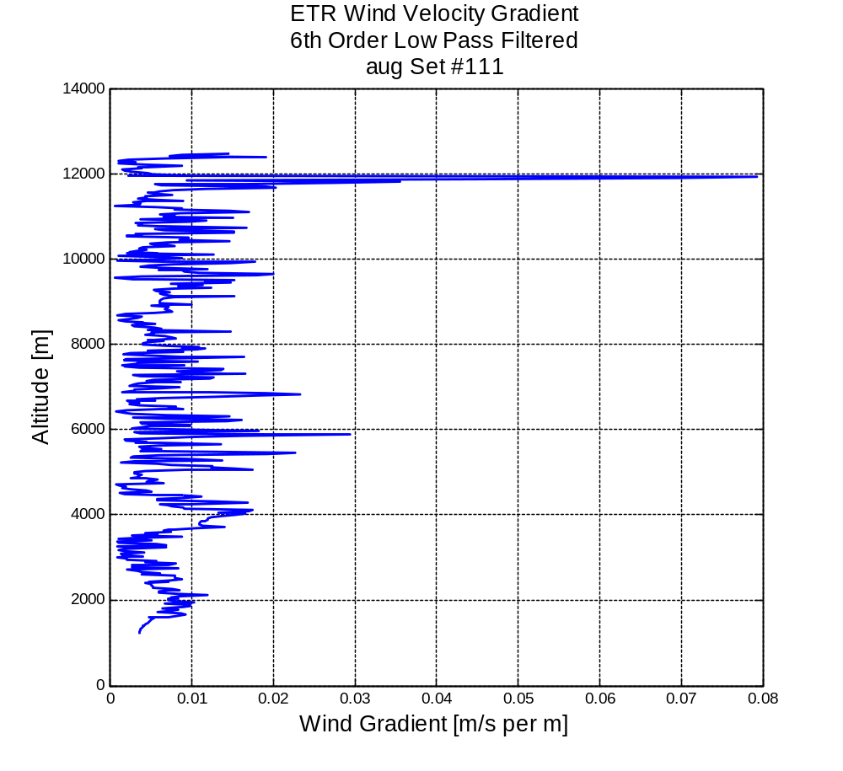
Worst Case Wind Gradient - Aug
Worst case sheer:
0.0793 [m/s per m]

Slide 18
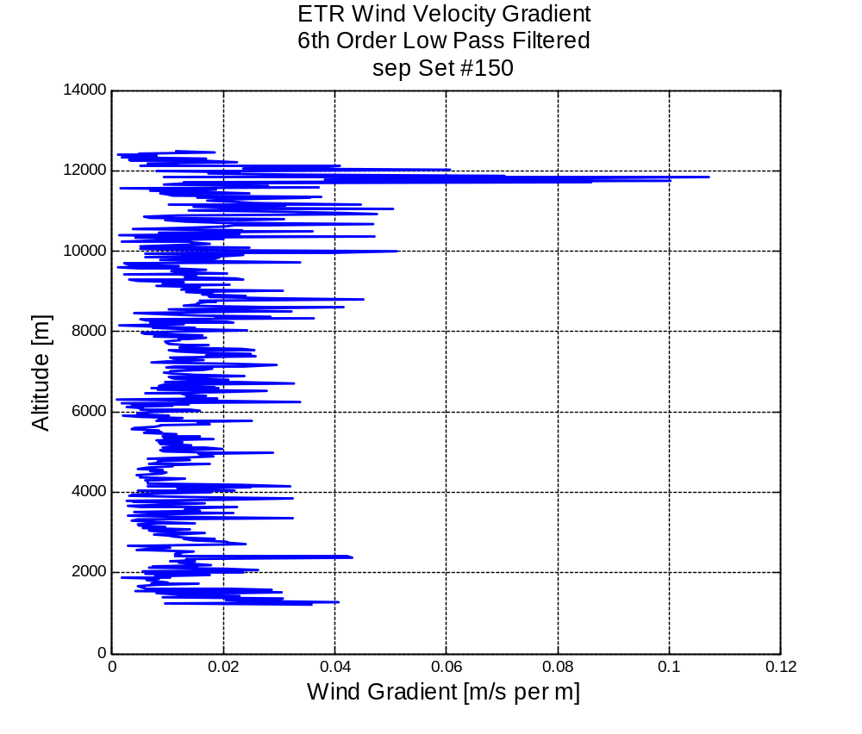
Worst Case Wind Gradient - Sep
Worst case sheer:
0.1073 [m/s per m]

Slide 19
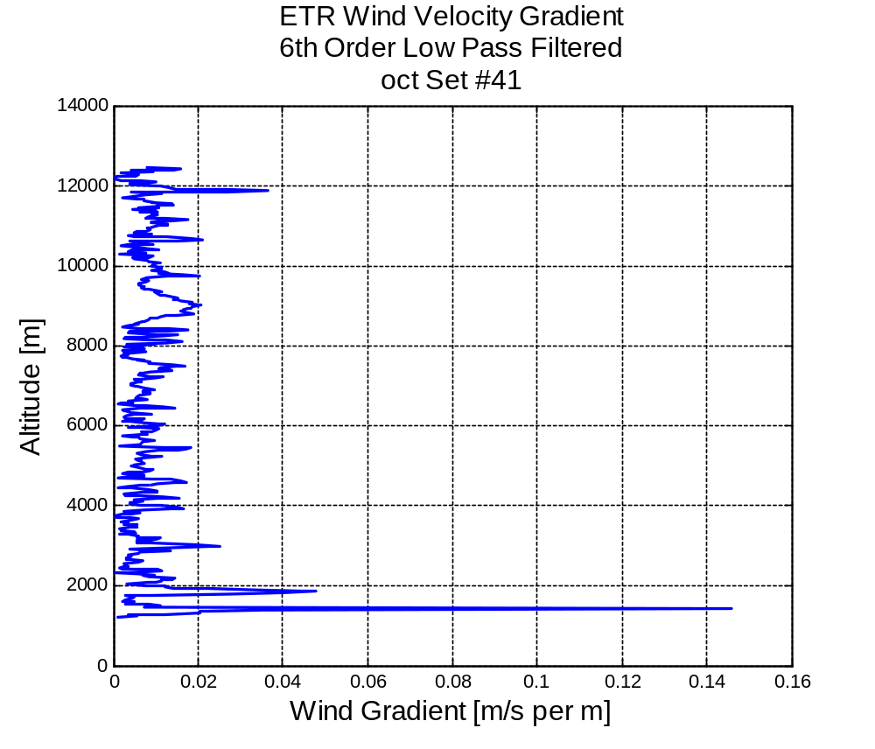
Worst Case Wind Gradient - Oct
Worst case sheer:
0.1458 [m/s per m]

Slide 20
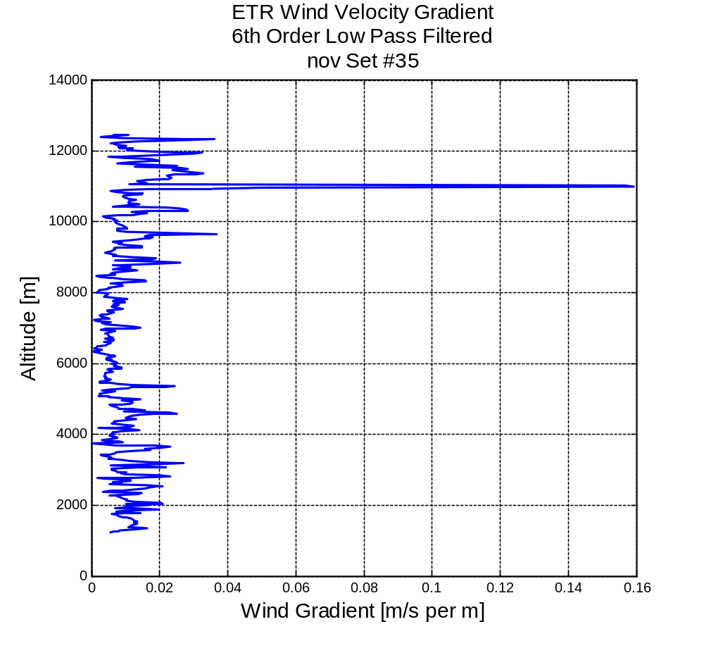
Worst Case Wind Gradient - Nov
Worst case sheer:
0.1593 [m/s per m]

Slide 21
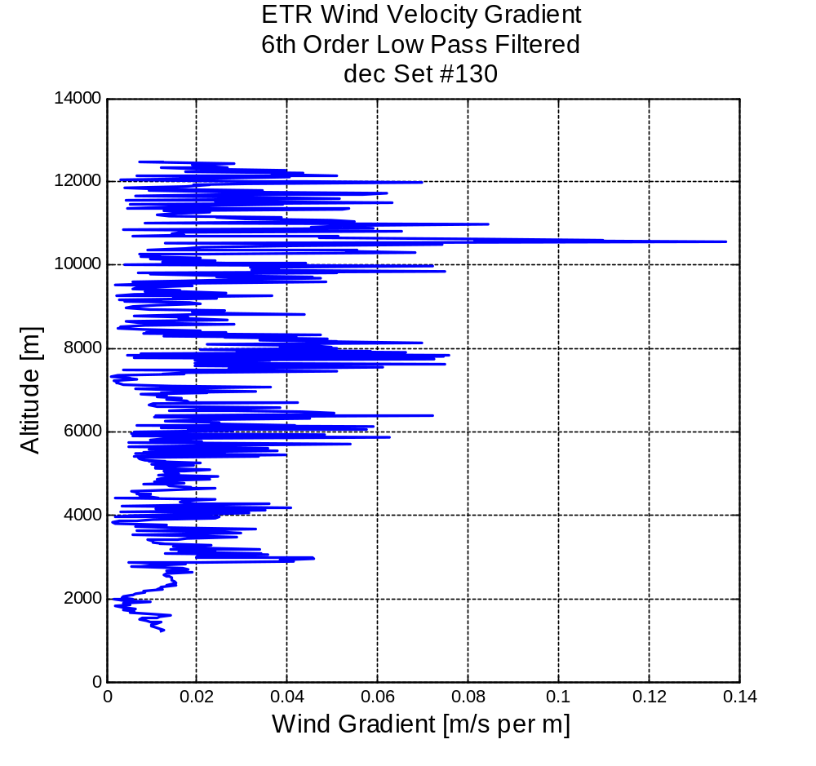
Worst Case Wind Gradient - Dec
Worst case sheer:
0.1372 [m/s per m]

